Slide 1

Simple Open-Vocabulary Object Detection with Vision Transformers
Ashna Ranganathan || Guia Mae Bongulto

Slide 2
Project Overview:
Goal: Understand how the modern vision language model responds to custom object request.
Model Used: OWL_ViT (zero-shot object detector)
Task: To detect the tree in the outdoor image.
Output: Boxes were put but they covered the entire image instead of just boxing in the tree.
Purpose: To evaluate the performance, identify the problems, improve the object detector.

Slide 3
What is Open-vocabulary object detection
Open-vocabulary object detection is an approach where a model can detect any object described in natural language, even if that object never appeared in the training set.
Traditional object detectors (like YOLO or Faster R-CNN) require:
A fixed list of class labels (e.g., “dog, person, car”)
Large annotated datasets for each class
Open-vocabulary detection removes this limitation. Instead of predicting from a fixed list, the model takes text prompts such as:
“a large green tree”
“a person holding a red umbrella”
“a gothic-style building”
The model then searches the image for regions that match the description rather than a preset category list.

Slide 4
Architecture Overview (Vision Transformer + Text Encoder)
OWL-ViT uses two major components:
1. Vision Transformer (ViT)
Takes the image as input.
Breaks it into patches (like tokens in a sentence).
Uses self-attention to understand relationships between image regions.
Outputs a high-dimensional image embedding that captures semantic meaning.
2. Text Encoder
Converts the text prompt (“tree,” “tall green tree,” etc.) into a text embedding.
Uses a transformer similar to BERT/T5 to encode language meaning.
Outputs a vector in the same embedding space as the images.

Slide 5
What is OWL_ViT
OWL_ViT is a vision language transformer that is trained for natural language object detection.
It takes an image and the text prompt and returns predicted boxes and similarity scores.
Strengths: zero-shot, text queries are flexible
Weaknesses: limited training categories, which means it struggles with unseen or unusual objects.

Slide 6
Implementation Setup
Use of HuggingFace OWL_ViT
Loaded model and processor
Used tree and bush as the prompt
Flooded the output boxes with PIL
We run the code in Jupyter Notebook/Google Colab
Notes:
Add code later

Slide 7

Input Example
Notes:
Add code later

Slide 8
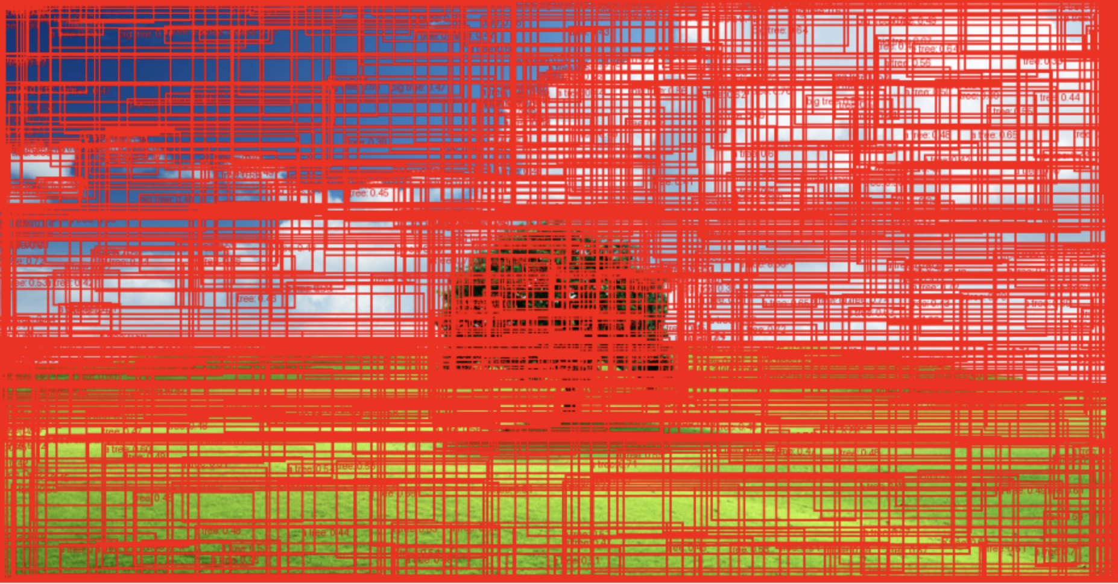
Output Example
Notes:
Add code later

Slide 9
Observed Errors
The boxes did not box the tree and were scattered everywhere
majority of the boxes are irrelevant. (Boxes placed on vertical lines that resemble tree trunks)
The model predicted objects that do not even exist, which is a normal issue with zero-shot models.
Model confused by background objects
The similarity scores were too low to confidently classify anything as a tree.
Strong tendency for oversensitive detection
Example failure patterns:
Lines mistaken for “tree trunks”
Patches of green mistaken for leaves
Notes:
Add code later

Slide 10
Why it failed?
Zero-shot limitation: OWL_ViT was not specifically trained to label “trees” in diverse ways.
Weak text embedding match: The prompt “tree” is too vague, so the model confuses the backgrounds, textures, and shapes.
Box uncertainty: The default box decoder often outputs too many low-quality proposals, without filtering boxes appear everywhere.
No thresholding: All boxes were drawn which led to visual clutter.
Notes:
Add code later

Slide 11
Recommendations and improvements
Add Confidence Thresholding: only show confidence predictions if more than 50% confident.
Use a Refined prompt: Use more detailed specific prompts
Notes:
Add code later

Slide 12
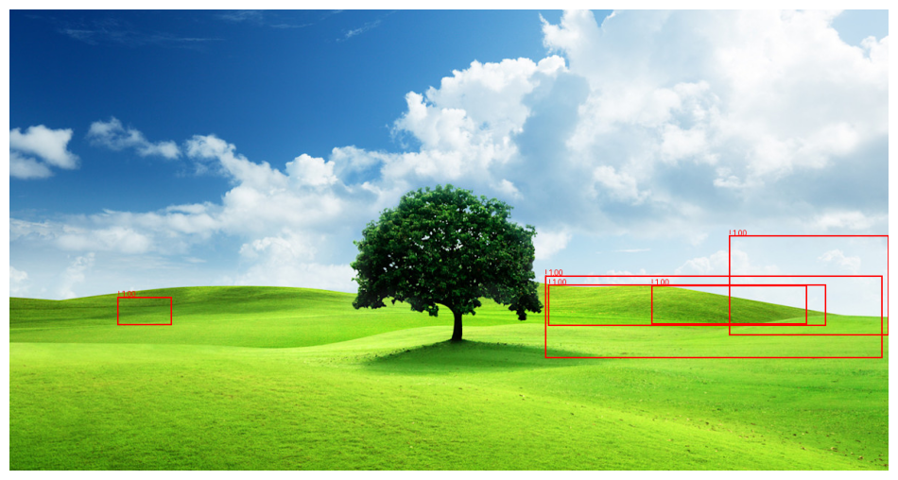
Use a Refined Prompt
Instead of using the prompt "tree" we used the prompt "green bush" as the trunk is not very visible so the tree resembles more of a bush.
Notes:
Add code later

Slide 13

Add Confidence Thresholding
In the code we changed the confidence threshold from 30% to 50% so it would only display the boxes it was super confident in.
Notes:
Add code later

Slide 14
What we learned
We learned that zero-shot models have limitations for specific object detection.
Vague language leads to visual confusion
Outputs can look corrects numerically but be visually incorrect.
Evaluation is necessary to understand real model behavior
Improvements can significantly increase the accuracy
Notes:
Add code later

Slide 15
Conclusion
By using AI models we learned that inaccurate outputs have to do with model limitations as zero-shot owl-vit produced. By adding improvements, we improved the model’s performance and accuracy to have a better output.
Future work:
Try fine-tuning OWL-ViT on a small custom dataset
Test additional prompt engineering strategies
Evaluate more advanced models like:
Grounding-DINO
Florence-2
SAM + Detic hybrid
Compare performance across images
Notes:
Add code later

